Slide 1
Visualization of multi-axis ultrasonic scanning route simulation for curved parts
Instructor：Yang Zhang
Student：Zizhuo Wang and others

Slide 2

1
Background
2
Reconstruction of curved parts
Contents
3
Scanning path planning
4
Coordinate matching and visualization
5
Summary

Slide 3
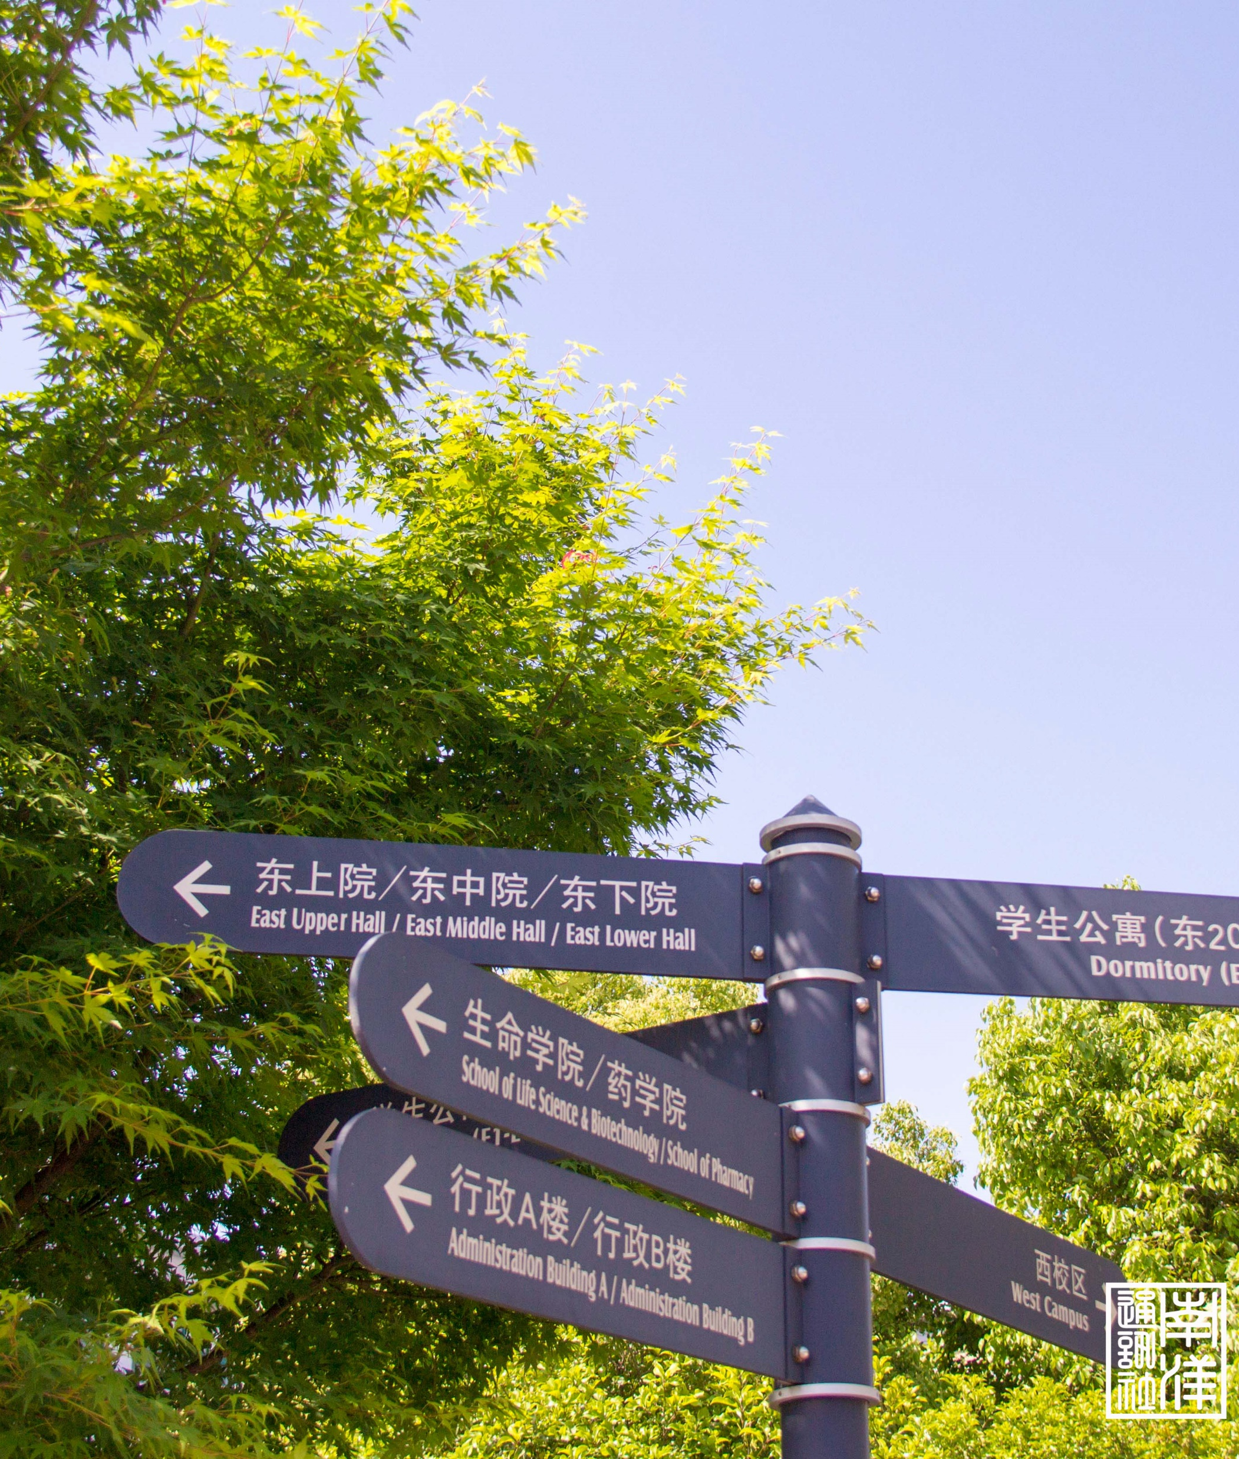
Background
01

Slide 4
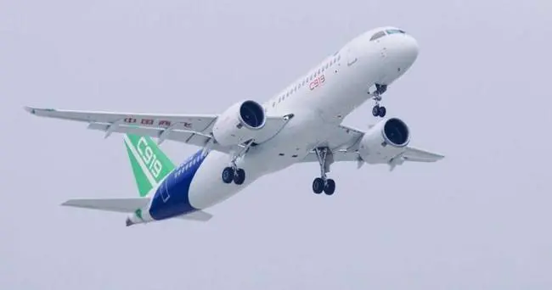
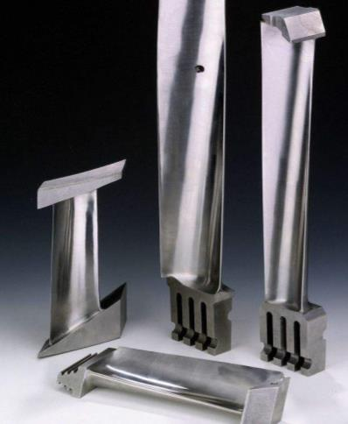
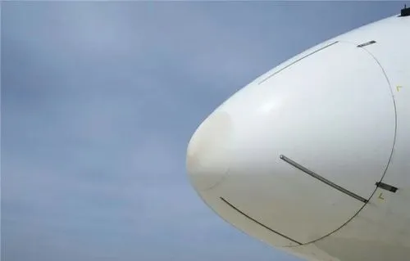
1.1 requirement of aviation surface scanning
The usage of sculptured surfaced parts has been increasing in multiple areas like aerospace or medical equipment.
The precision of defect detection is required, for example in airplanes.
C919
Engine blade
Radar cover
Requirement: scanning curves in a plane requires high precision, high stability and high efficiency.

Slide 5
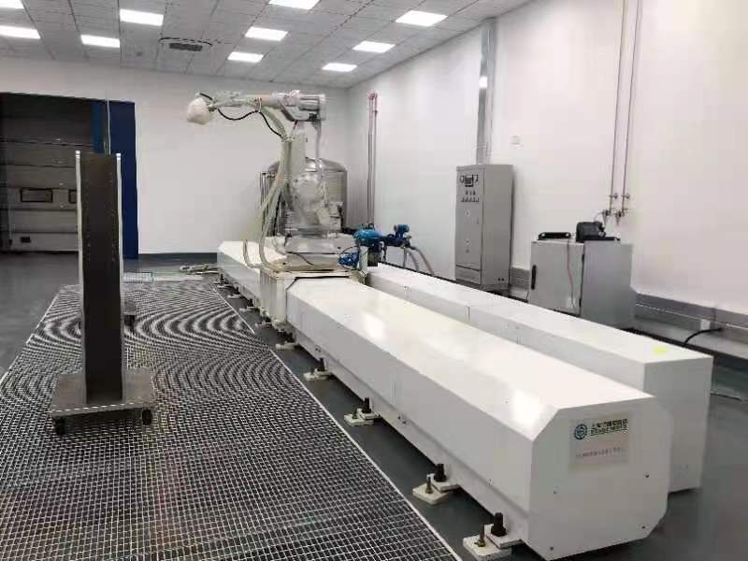
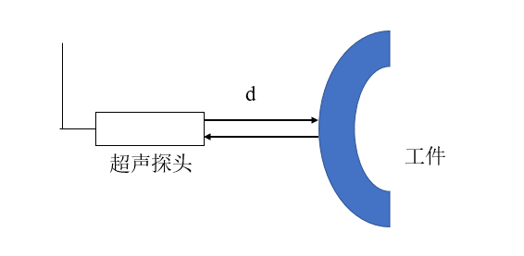
1.2 Methods of aviation surface scanning
A Six axis robotic arm ultrasonic scanning system with guide rail is used in this project to conduct nondestructive test of parts with sculptured surface.
Working principal of ultrasonic detection
Robot arm scanning system with guide rail
Strong penetration, high sensitivity to defects such as interlayers and cracks;
Safe to manipulate
High degree of freedom, capability of detecting workpieces with sculptured surface;
Strong applicability

Slide 6
Reconstruction of curved parts
02

Slide 7
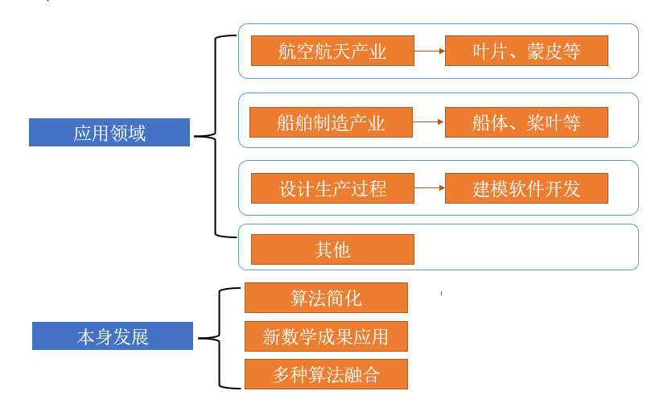
2.1 Literature research and scheme selection
Triangular reconstruction
aerospace
Blade, gauge skin
Bezier curves and surfaces
application
Shipbuilding
Blade, hull
Coons surface
Design process
Modelling software
other
B-spline curves and surfaces
Algorithm simplification
Math achievements application
NURBS curves and surfaces
development
Multiple algorithm fushion
Research content in the field of reconstruction
Reconstruction methods

Slide 8
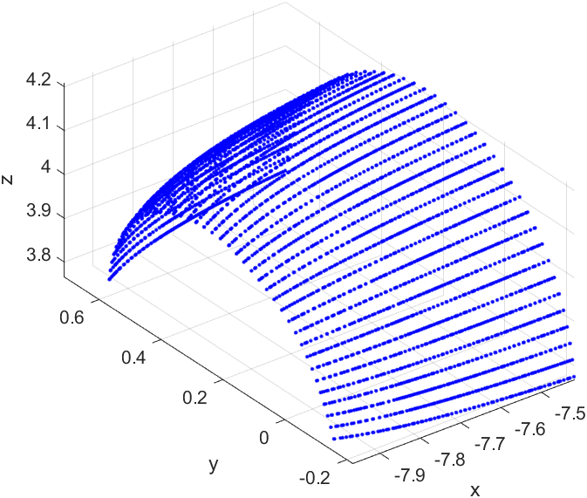
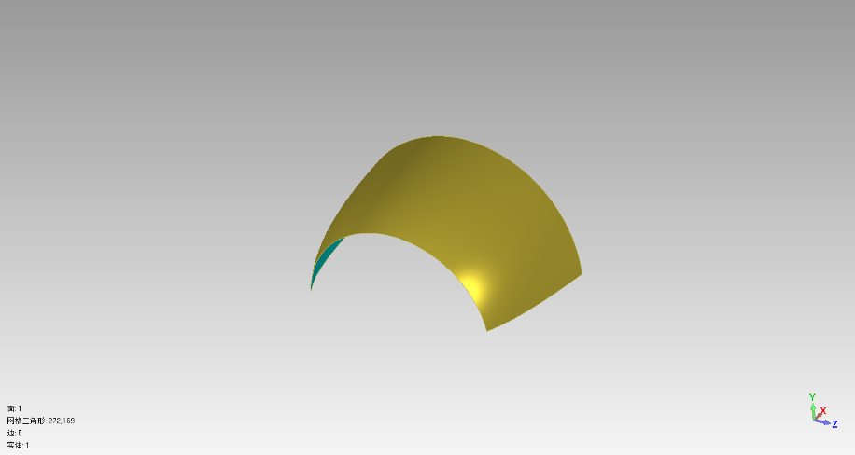
2.1 Literature research and scheme selection
Reconstruction of Cross-sectional line
Reconstruction of surface
Analysis of reconstructed surface
Work flow
Test data: head gauge skin of a large aircraft

Slide 9
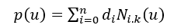
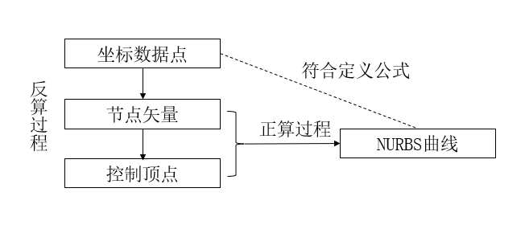
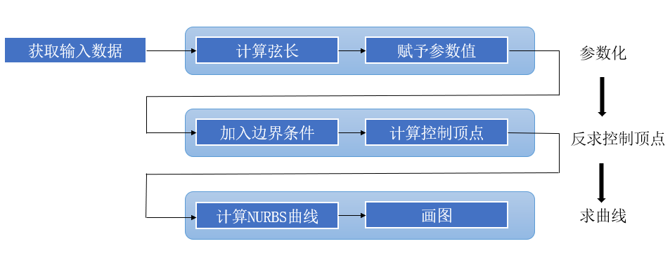
2.2 Reconstruction of Cross-sectional line
Data point coordinate
Back
solve
Node vector
Parameterization
Direct
solve
NURBS curve
Control point
uniform
chord
Input data
Solve chord length
Assign parameters
parameterize
Corrected chord
Boundary condition
Add boundary condition
Solve control points
Solve control point
Close curve
Solve NURBS curve
generate curve
Solve curve
Open curve
Program structure of reconstruction

Slide 10
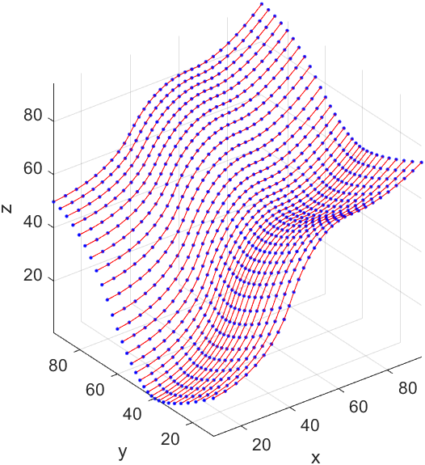
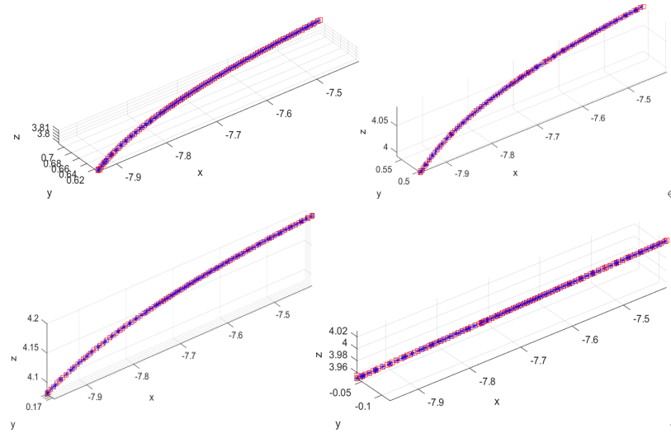
2.2 Reconstruction of Cross-sectional line
Result of cross-sectional line reconstruction with sample curve

Slide 11
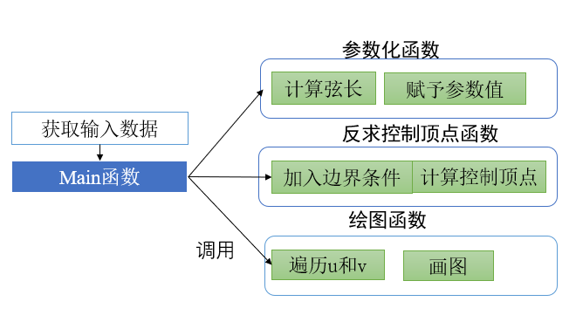
2.3 Reconstruction of surface
Main method：A surface is an extension of curves.
Parameterize function
Solve chord
Apply parameter
View reconstructed curves as data points
Data input
Control point function
Main function
Apply boundary condition
Solve control
points
Figure function
Ergodic u and v
Generate figure
Program structure of surface reconstructure

Slide 12
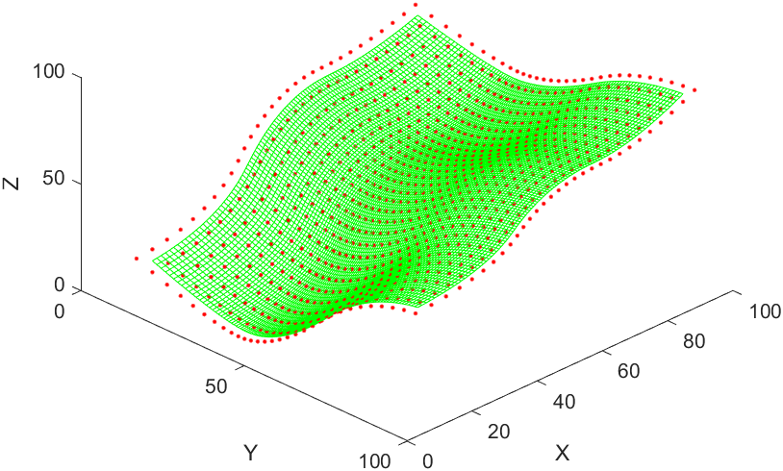
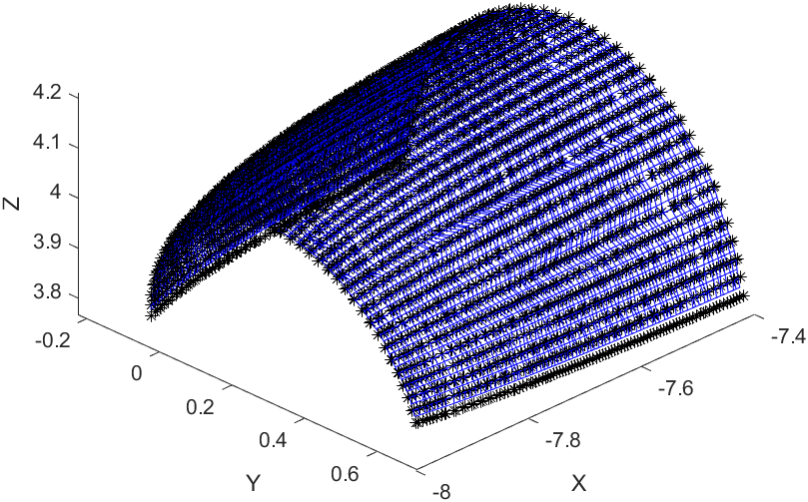
2.3 Reconstruction of surface
Result of reconstruction of sample surface

Slide 13
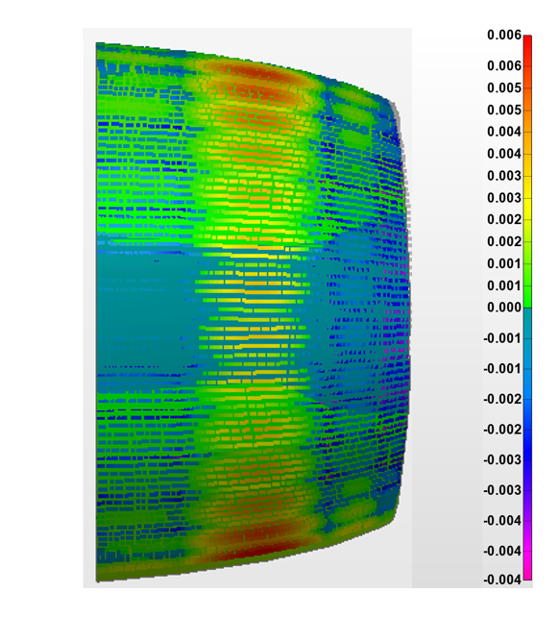
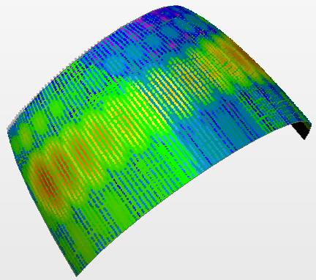
2.4 analysis of reconstructed surface
Model matching with ICP
Distance calculation
Analysis
Error of reconstructed surface and real surface
Error: 0.19%

Slide 14
Scanning path planning
03

Slide 15
3.1 sampling method of test point —— step length
W
d1
L
d2
Circular probe
Rectangular probe
To increase scanning efficiency, step length takes the maximum which is determined by shape of the probe.

Slide 16
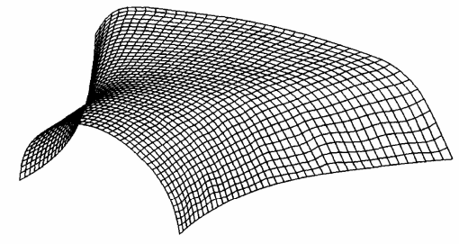
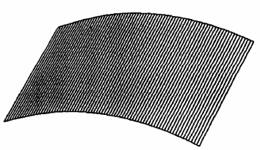
3.1 sampling method of test point
Equal parameter
Parallel section
A series of cross-section lines is obtained by equally divide surface parameter along one direction
Intersects a series of parallel planes and test surface. The intersection points are test points
Advantage: convenient, easy to apply
Disadvantage: high demand of part shape, unequal step length
Method chosen：equal arc method

Slide 17
3.1 sampling method of test point —— equal arc
Dense equal parameter discretization
Find the interval of equal parameter points with arc and functions
Solve test point coordinates with equal arc parameters
Linear interpolation base on interval endpoints
Equal arc
Equal parameter

Slide 18
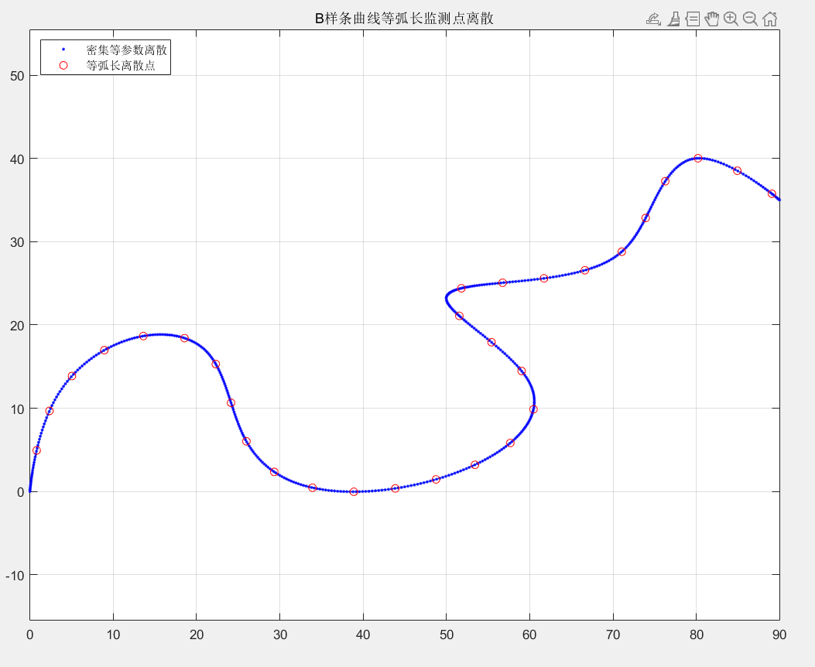
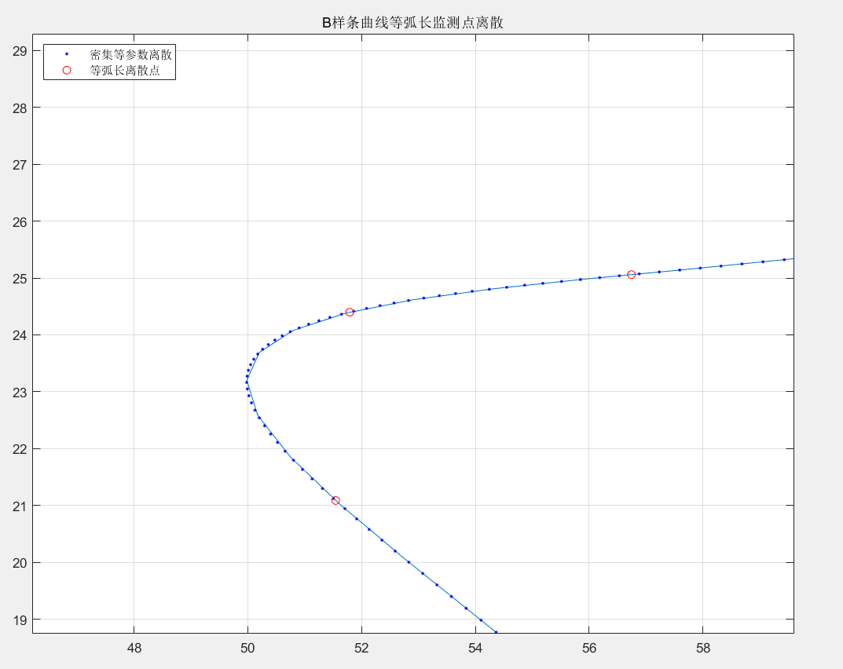
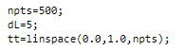
3.1 sampling method of test point —— equal arc
Result of discretization of sample lines

Slide 19
3.2 Method of path planning
Surface equal parameter discretization
Curve reconstruction on U direction
Get data points by discretization the surface;
Reconstruct data points into curves along U direction;
Equal arc separates reconstructed curves to get data point with equal arc along U direction;
Reconstruct these points along V direction into B-spline curves;
Equal arc separates B-spline curves.
Find nearest data points of the generated points, get equal arc point coordinates and parameters.
Equal arc separation
Solve nearest point
Curve reconstruction on V direction

Slide 20
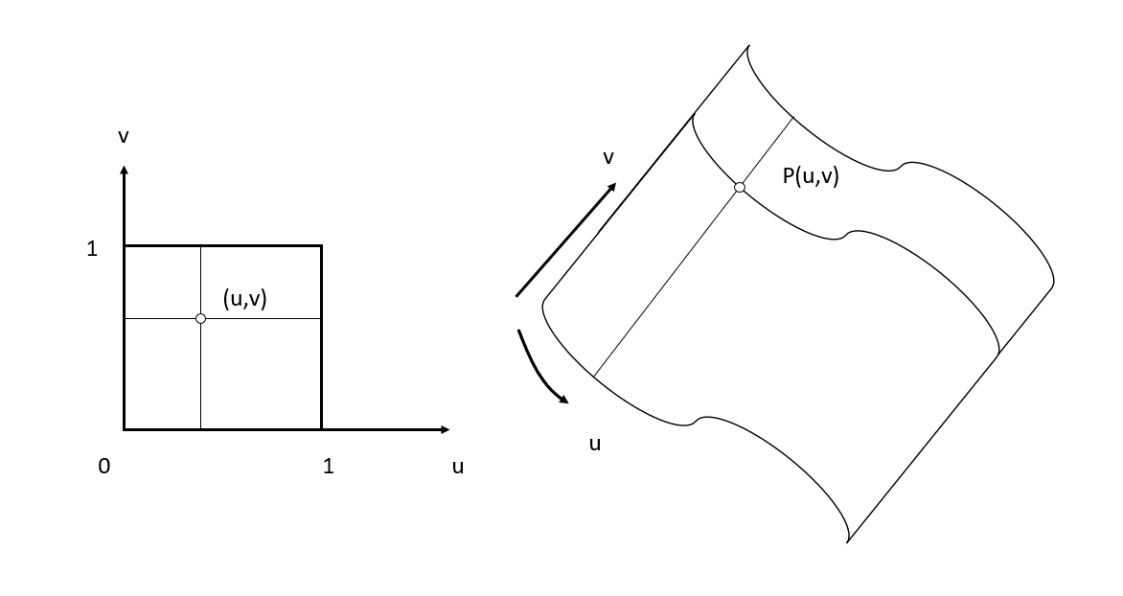
3.2 method of path planning——determine attitude
Solve normal vector:
n
Mapping relationship between points on surface and points in parameter field

Slide 21
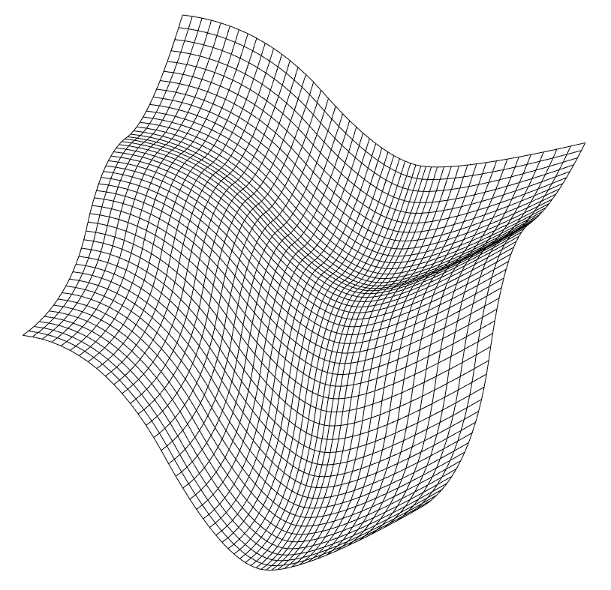
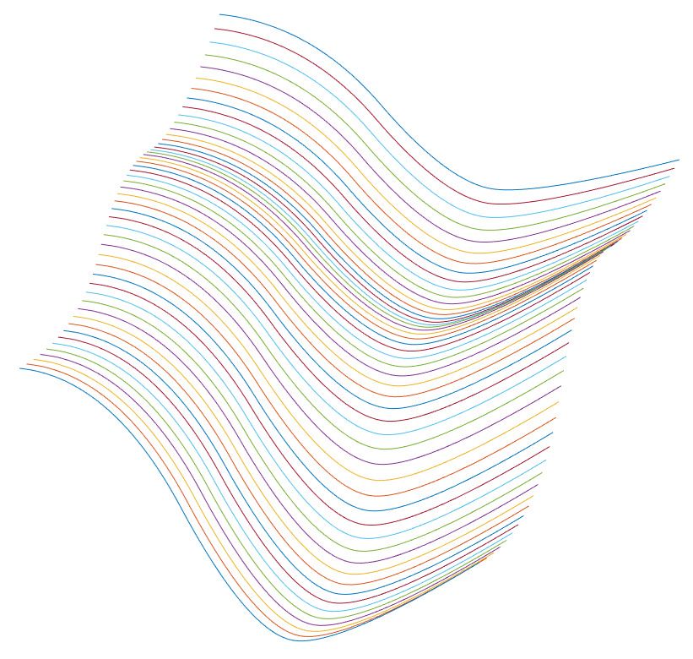
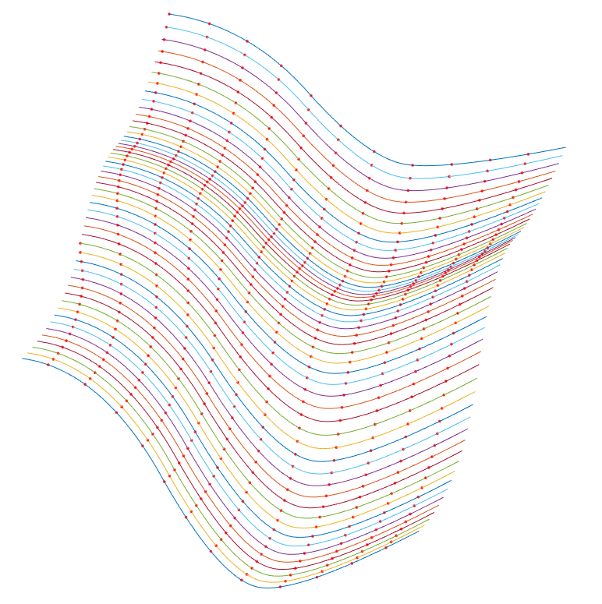
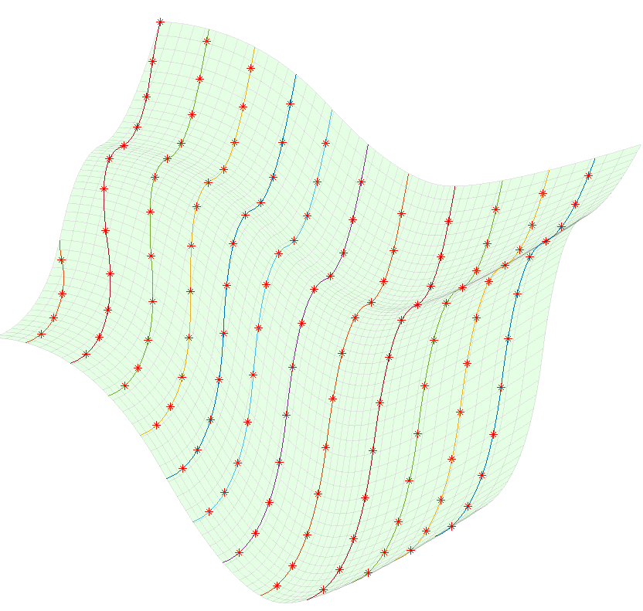
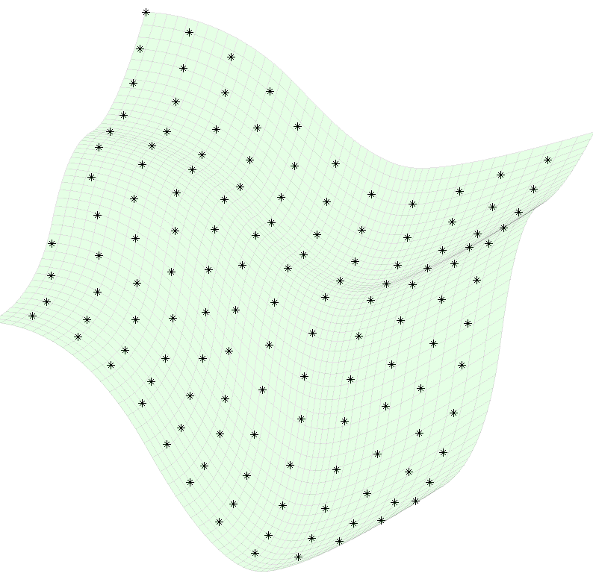
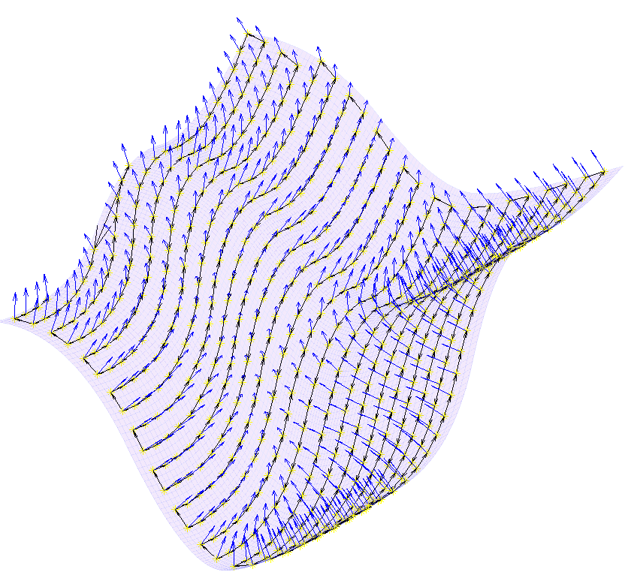
3.2 method of path planning——result
1
2
3
4
5
6

Slide 22
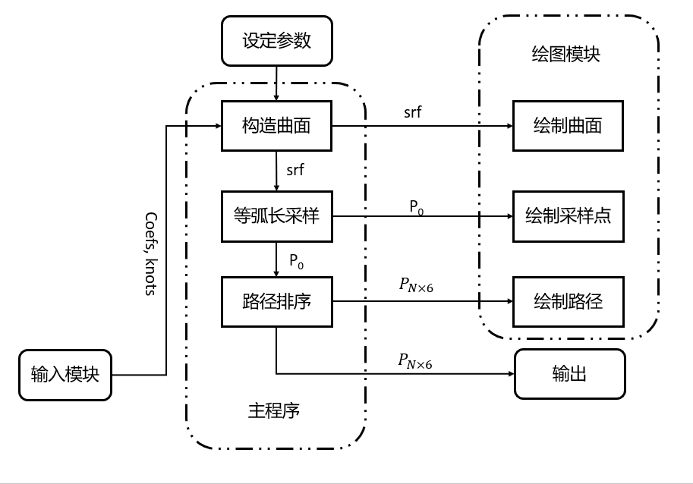
3.2 method of path planning——program structure
Set parameters like arc length and search accuracy
Set parameters
Display module
Reconstruct surface
Display surface
Equal chord sample
Display points
Input surface control points and node matrices
Array path points
Display path
Input module
output
Main function

Slide 23
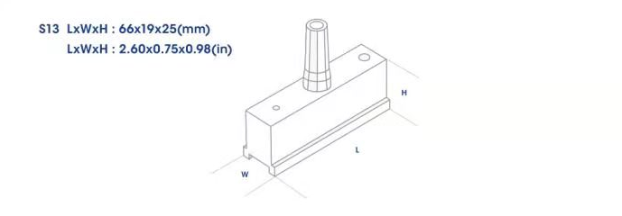
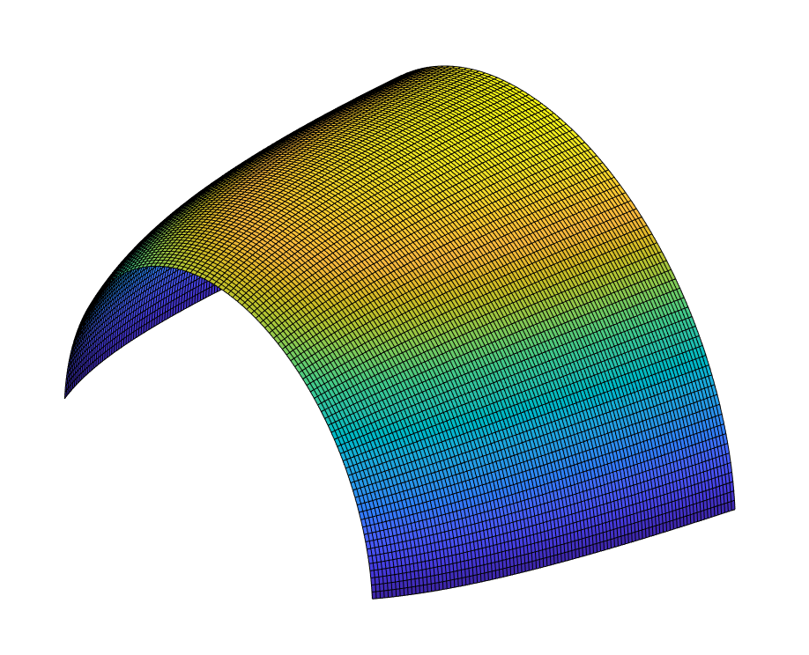
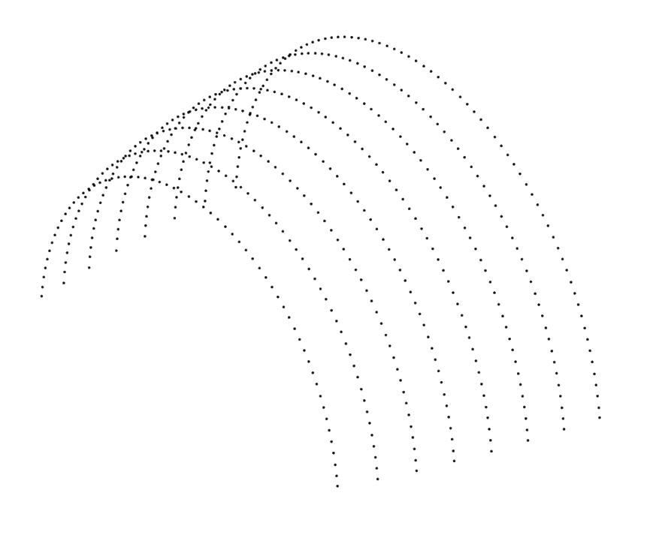
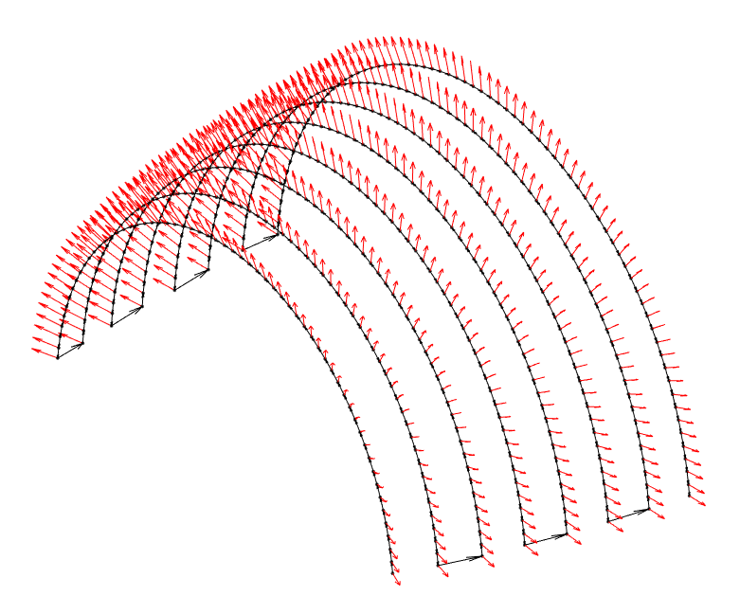
3.3 Simulation test
Length (distance between curves) /mm | Width（distance between points）/mm | Total mesure points
66×0.8 | 39×0.8 | 558
Chord parameter
Reconstruct surface
Solve equal chord points
Solve path and posture

Slide 24
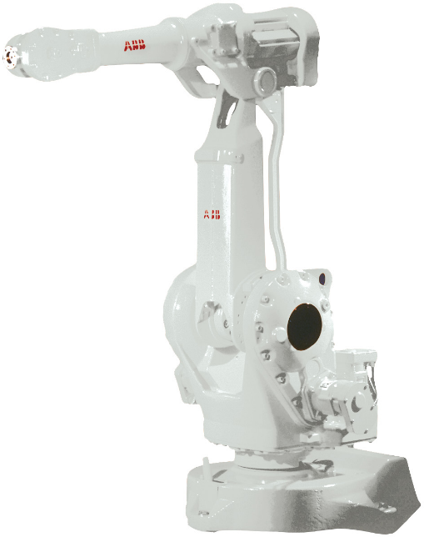
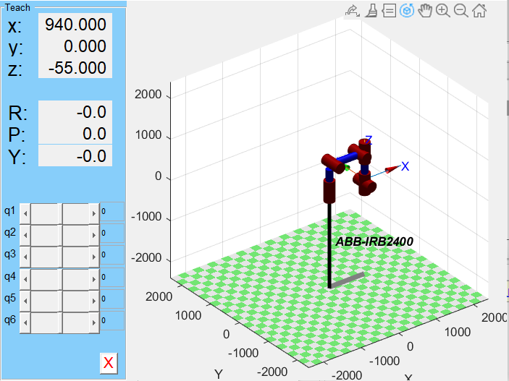
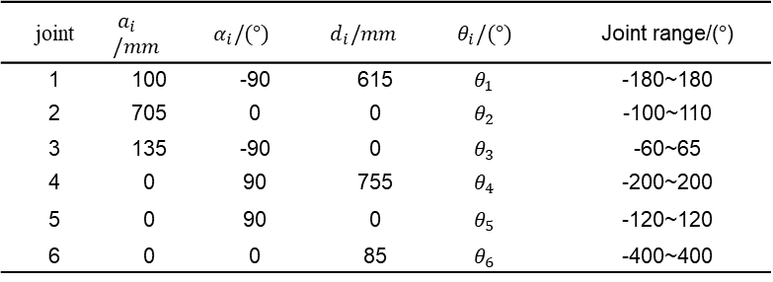
3.3 Simulation test —— scanning simulation
Parameters of IRB 2400 D-H
joint | $$a_{i}/mm$$ | $$α_{i}/(°)$$ | $$d_{i}/mm$$ | $$θ_{i}/(°)$$ | Joint range/($°$)
1 | 100 | -90 | 615 | $$θ_{1}$$ | -180~180
2 | 705 | 0 | 0 | $$θ_{2}$$ | -100~110
3 | 135 | -90 | 0 | $$θ_{3}$$ | -60~65
4 | 0 | 90 | 755 | $$θ_{4}$$ | -200~200
5 | 0 | 90 | 0 | $$θ_{5}$$ | -120~120
6 | 0 | 0 | 85 | $$θ_{6}$$ | -400~400
IRB2400
Establish arm model

Slide 25
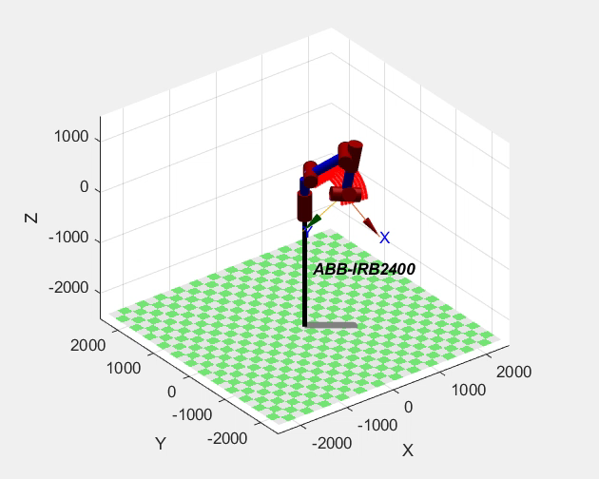
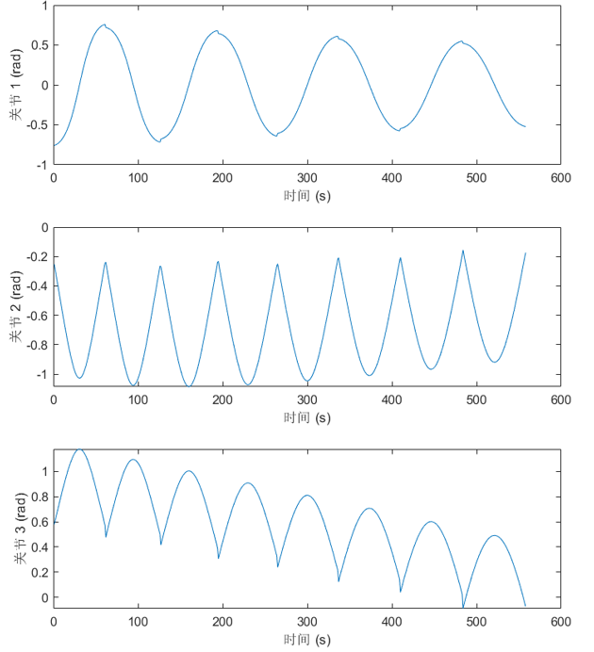
3.3 Simulation test —— scanning simulation
Transform path and attitude coordinates and input into MATLAB simulation environment.
The result of planned scanned path shows as follow:
Scanning path points of robot arm
Posture change of some joints

Slide 26
Coordinate matching and visualization
04

Slide 27
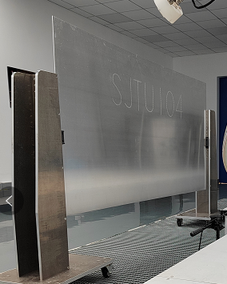
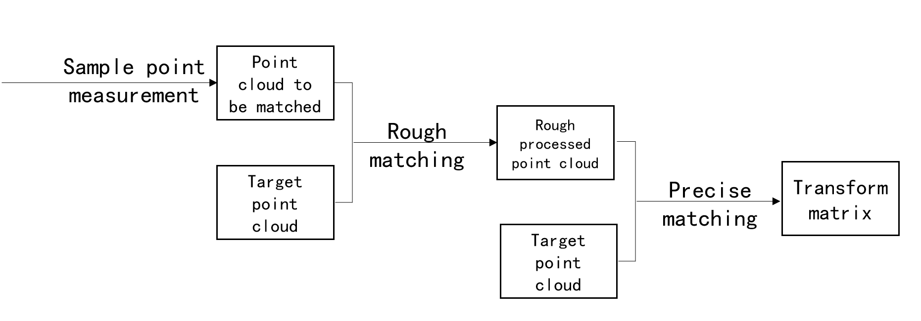

4.1 Matching method of coordinates
The scanning process requires repeated scanning of multiple parts with same appearance.
The procedure of sampling, reconstructing and path generating is carried out repeatedly because of repeated clamping and incomplete clamping.
With the help of point cloud matching method, fewer sample point can accomplish the relocation of scanning path.
Rotation matrix and translation matrix are solved and the error becomes minimal when Q = R * P + t.
$$E\left(R,t\right)=\frac{1}{n}\sum_{k=1}^{n}{{\left\|q_{k}−\left(R_{p_{k}}+t\right)\right\|}^{2}}$$

Slide 28
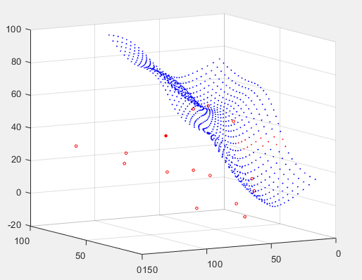
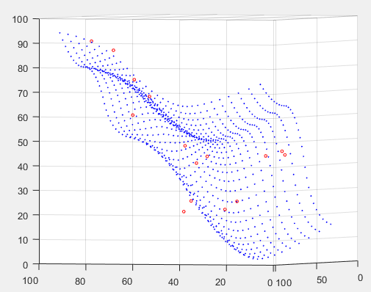
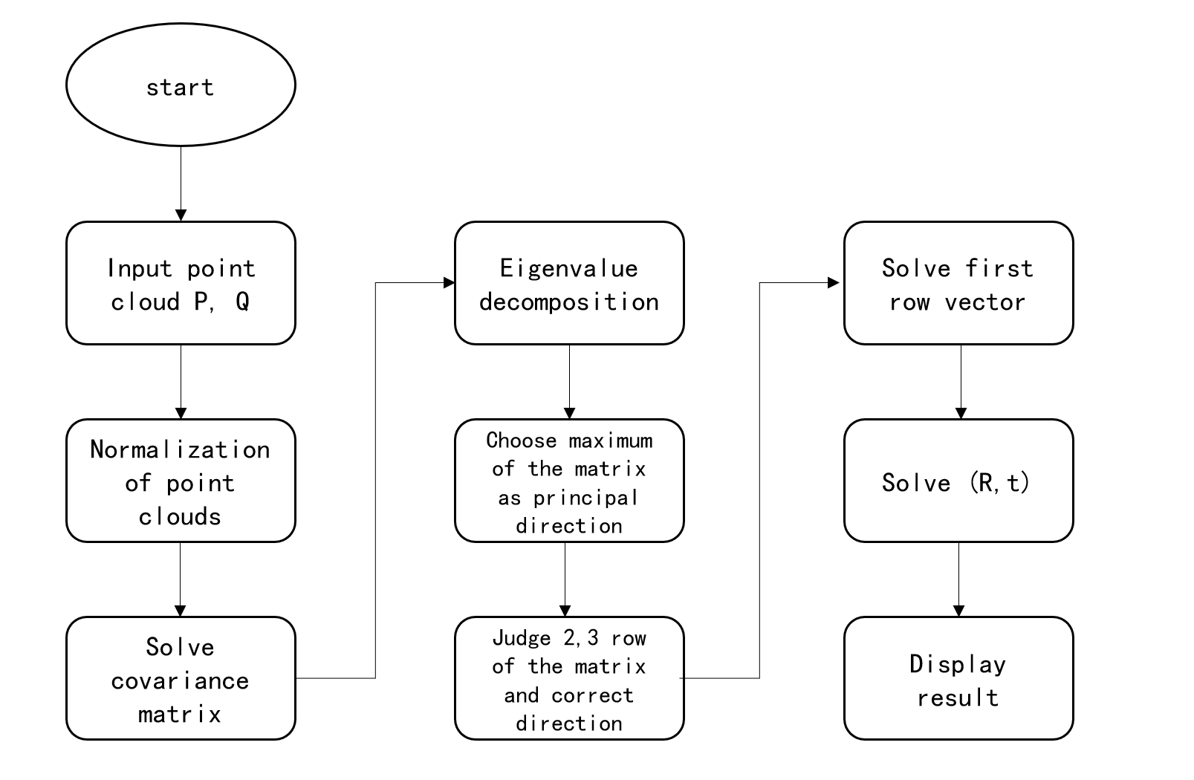
4.1 Matching method of coordinates
Rough matching method: Principal Component Analysis (PCA)
Method: To solve principal axis of the point clouds and match their direction.
Advantage: Can roughly match two point clouds with rather high speed.
Disadvantage: Matching precision is rather low.
Before PCA
After PCA

Slide 29
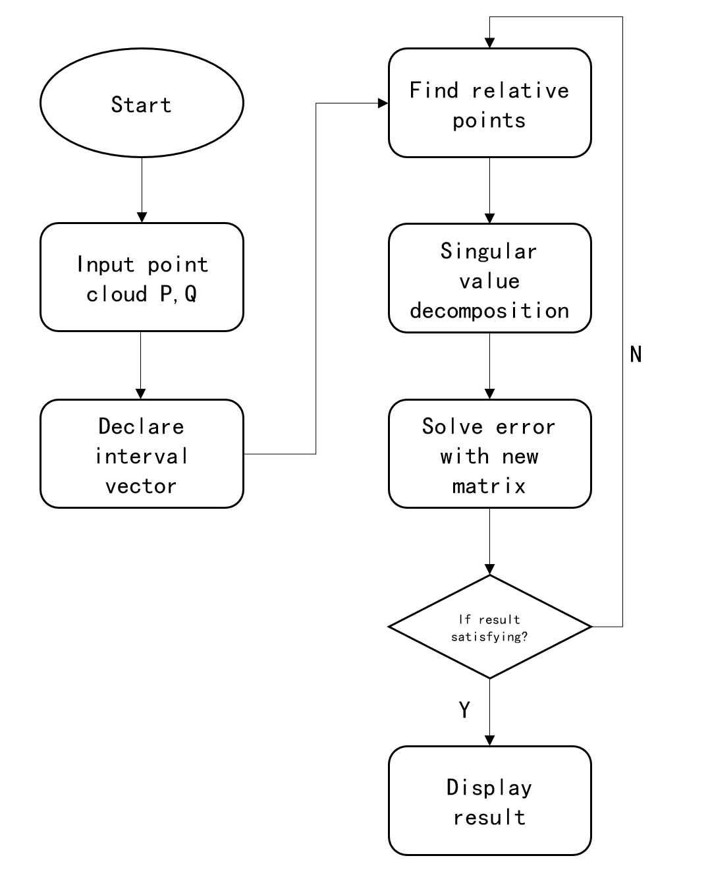
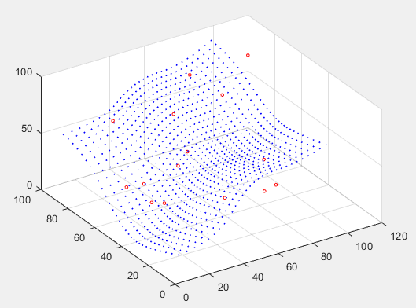
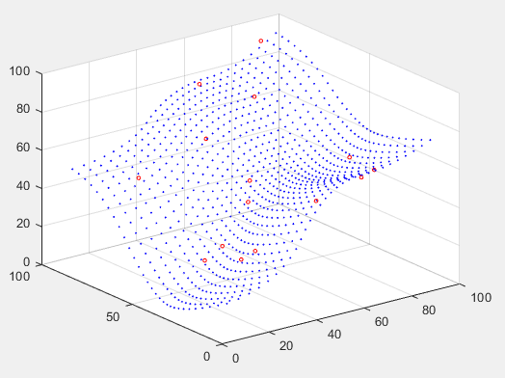
4.1 Matching method of coordinates
Precise matching method: iterative closest point (ICP)
For every point ax in point cloud A, the closest point bx in cloud B is found. The two point clouds are matched so that error Ex is minimal.
This process is repeated until E becomes minimal.
Advantage: Matching precision is high.
Disadvantage: Time consumption is rather high and may
Result in local optimal solution.
After PCA
After ICP

Slide 30
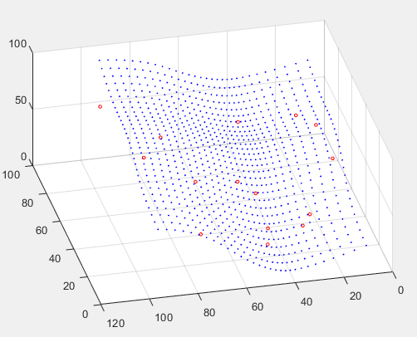



4.1 Matching method of coordinates
Disadvantage of ICP
ICP result Without PCA
error
ICP result With PCA
error

Slide 31




4.1 Matching method of coordinates
Choosing method of sample points
$Δ_{ε}=\frac{\left|S_{△ABC}−S_{△A′B′C′}\right|}{S_{△ABC}}$
In general：
（1）Distance between sample
points should be as large as possible.
（2）Unilateral triangles should be chosen.
When conducting coordinates matching:
Points with obvious geometric feature (larger curvature) should be chosen.
25 points are chosen to satisfy both sampling speed and error range.
Matching error
Number of sample points

Slide 32



4.2 visualization of scanning path

Slide 33




4.3 simulation experiment based on head gauge skin of a large aircraft
Iterated 18 times until error reduced to 0.97

Slide 34
Summary
05

Slide 35
5 Summary
Reconstruction of curved parts
Goal
Method
To establish a surface model based on point clouds and evaluate reconstruction quality.
Used NURBS curve and surface reconstruction
Result
Finished reconstruction of free-form prats as planned, with evaluated quality being acceptable.
Lack of data prepossessing and physical experiment.

Slide 36
5 Summary
Scanning path planning
Goal
Method
To solve a path with reliable and complete result.
To reduce test points and increase efficiency.
Generated sample points with equal chord method and zig-zag scanning.
Result
Finished path planning with equal chord method as planned, and the result path meets primary goals.
Calculation efficiency can be increased.
Time complexity can be reduced.
Program structure can be optimized.

Slide 37
5 Summary
Coordinate matching and visualization
Goal
Method
To match coordinate of scanning path and robot movement;
To accomplish visualization and simulation of the scanning path.
Combinatorial algorithm including PCA and ICP;
Visualization and simulation software made with qt.
Result
Achieved coordinate matching as planned;
Scanning path point cloud displayed and scanning process simulated.
ICP method can be optimized.
Visualization software requires more modules and display modes.
Lack of physical experiment.

Slide 38
Thank you for listening!

